Slide 1
Mathematics of Cryptography: Algebraic Structure
Dr. B C Dhara
Department of Information Technology
Jadavpur University

Slide 2
Objectives
Review the concept of algebraic structures
Define and give some examples of groups
Define and give some examples of rings
Define and give some examples of fields
Emphasize the finite fields of type GF(2^{n}) that make it possible to perform operations such as addition, subtraction, multiplication, and division on n-bit words in modern block ciphers
B C Dhara, Dept. of IT, JU

Slide 3
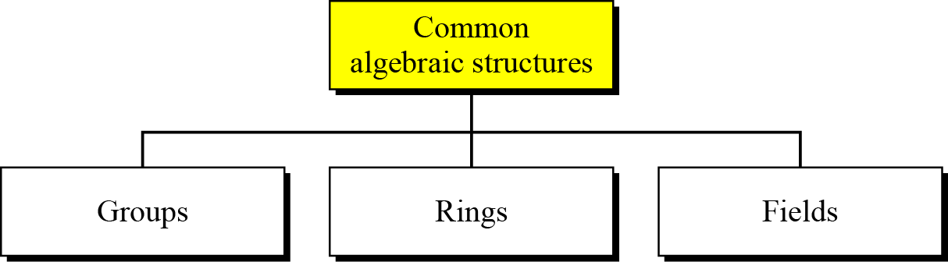
ALGEBRAIC STRUCTURES
Cryptography requires sets of integers and specific operations that are defined for those sets
The combination of the set and the operations that are applied to the elements of the set is called an algebraic structure
In this chapter, we will define three common algebraic structures: groups, rings, and fields.
B C Dhara, Dept. of IT, JU

Slide 4
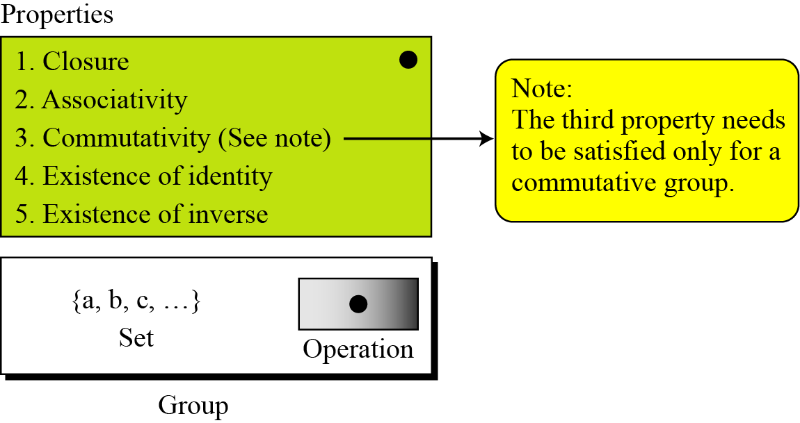
Groups
A group (G) is a set of elements with a binary operation (•) that satisfies four properties (or axioms), denoted as (G, •)
Closure: for all a, b ∈ G, a • b ∈ G
Associativity: for a, b, c ∈ G, (a • b) • c = a • (b • c)
Existence of identity: for all a ∈ G, there is e ∈ G such that a • e = e • a = a, e is the identity element
Existence of inverse: for all a ∈ G, there is b ∈ G such that a • b = b • a = e, b is inverse of a and vice versa
B C Dhara, Dept. of IT, JU

Slide 5
Groups (contd…)
A group (G, •) is called commutative or abelian group if the operator ‘•’ satisfies the commutative property
  Commutative property: for all a, b ∈ G, a • b = b • a
Although a group involves a single operation, the properties imposed on the operation allow the use of a pair of operations as long as they are inverses of each other.
B C Dhara, Dept. of IT, JU

Slide 6
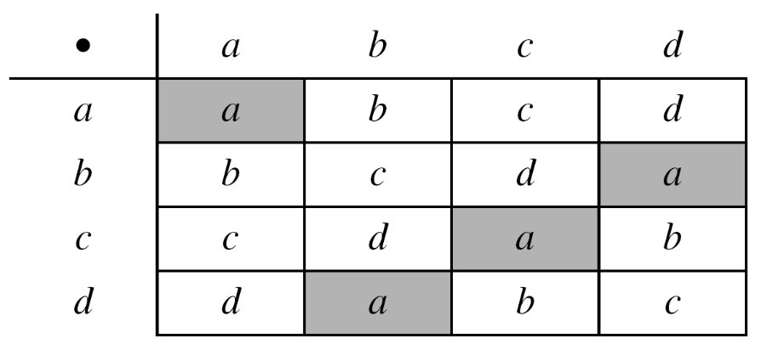
Example: groups
The set of residue integers with the addition operator,
G = < Z_{n} , +>,
is a commutative group. We can perform addition and subtraction on the elements of this set without moving out of the set.
The set Z_{n}* with the multiplication operator, G = <Z_{n}*, ×>, is also an abelian group.
Let us define a set G = < {a, b, c, d}, •> and the operation as shown in following table
This is an abelian group
B C Dhara, Dept. of IT, JU

Slide 7
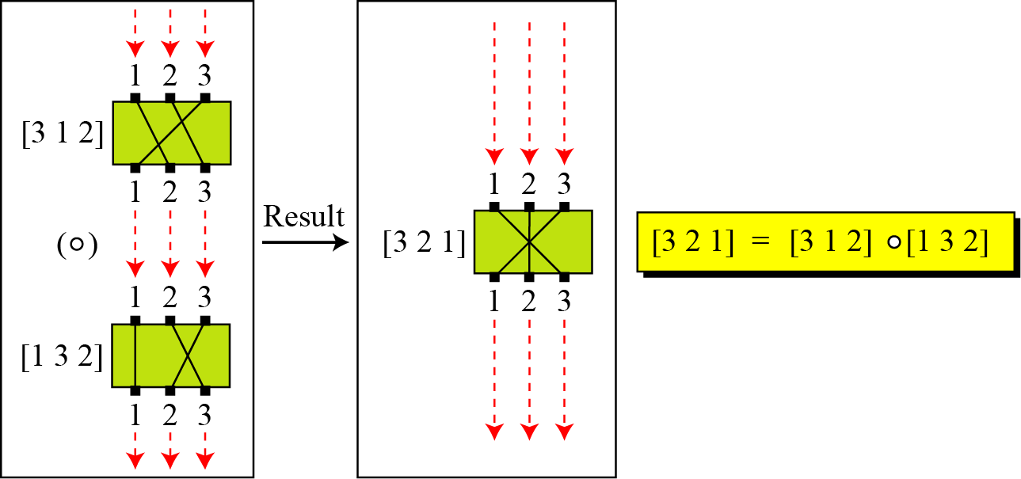

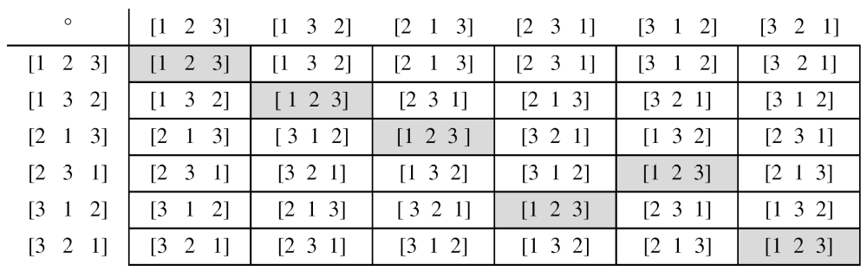
Permutation group
B C Dhara, Dept. of IT, JU

Slide 8
Permutation group
set of permutations with the composition operation is a group
  This implies that using two permutations one after another cannot strengthen the security of a cipher
    because we can always find a permutation that can do the same job because of the closure property
B C Dhara, Dept. of IT, JU

Slide 9
Groups (contd…)
Finite Group: a group with finite elements; otherwise, infinite group
Order of a Group: |G|, number of elements if finite; otherwise, infinite
Subgroups: A subset H of G is a subgroup of G if H is a group under the operation of G
B C Dhara, Dept. of IT, JU

Slide 10
subgroups
If a, b ∈ G, H ➔ c = a • b ∈ G, H
e ∈ G, H
If a ∈ G, H ➔ If a⁻¹ ∈ G, H
({e}, •) is subgroup of G, H
G is a subgroup of itself
B C Dhara, Dept. of IT, JU

Slide 11
Example: subgroup
Is the group H = <Z₁₀, +> a subgroup of the group G = <Z₁₂, +>?
The answer is no. Although H is a subset of G, the operations defined for these two groups are different. The operation in H is addition modulo 10; the operation in G is addition modulo 12.
B C Dhara, Dept. of IT, JU

Slide 12
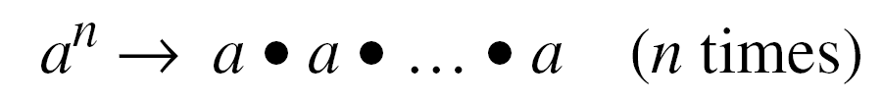
Cyclic Subgroups
If a subgroup of a group can be generated using the power of an element, the subgroup is called the cyclic subgroup
B C Dhara, Dept. of IT, JU

Slide 13
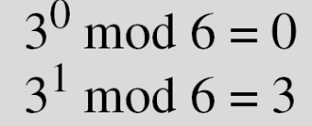

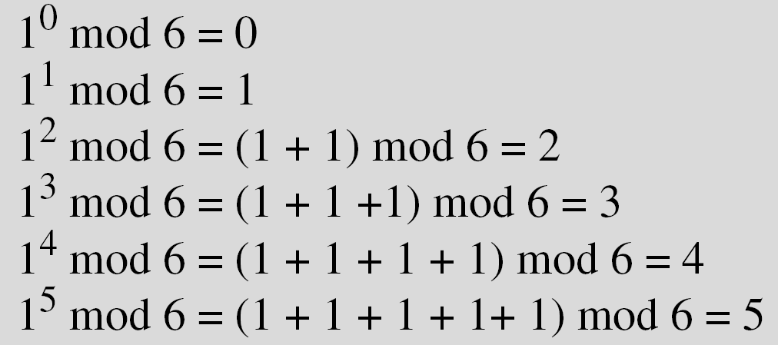
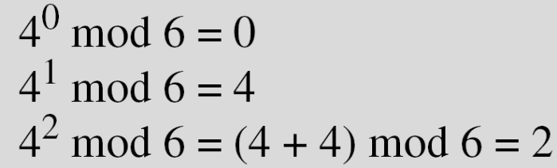
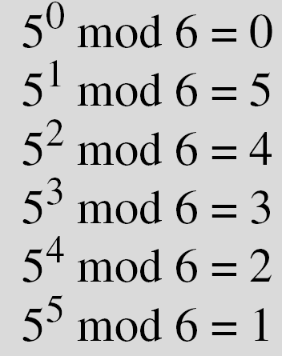
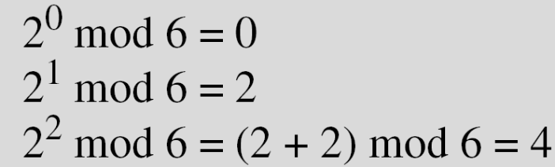
Example: cyclic subgroup
Four cyclic subgroups can be made from the group G = <Z₆, +>. They are H₁ = <{0}, +>, H₂ = <{0, 2, 4}, +>, H₃ = <{0, 3}, +>, and H₄ = G.
B C Dhara, Dept. of IT, JU

Slide 14
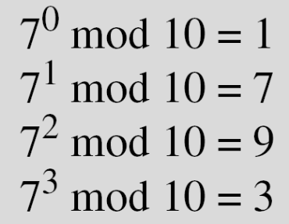

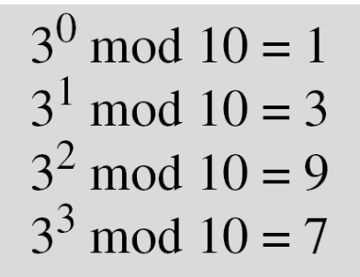
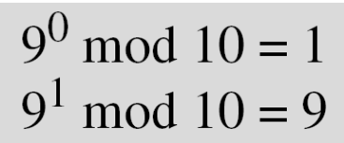
Example: cyclic subgroup
Three cyclic subgroups can be made from the group
G = <Z₁₀∗, ×>. G has only four elements: 1, 3, 7, and 9. The cyclic subgroups are H₁ = <{1}, ×>, H₂ = <{1, 9}, ×>, and H₃ = G.
B C Dhara, Dept. of IT, JU

Slide 15
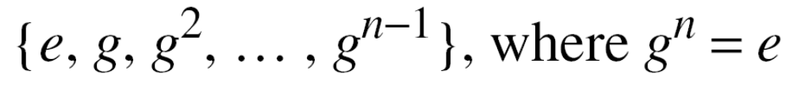
Cyclic Groups
A cyclic group is a group that is its own cyclic subgroup.
B C Dhara, Dept. of IT, JU

Slide 16
Cyclic Groups
Three cyclic subgroups can be made from the group
G = <Z₁₀∗, ×>. G has only four elements: 1, 3, 7, and 9. The cyclic subgroups are H₁ = <{1}, ×>, H₂ = <{1, 9}, ×>, and H₃ = G.
a. The group G = <Z6, +> is a cyclic group with two generators,
g = 1 and g = 5.
b. The group G = < Z₁₀∗, ×> is a cyclic group with two generators,
g = 3 and g = 7.
B C Dhara, Dept. of IT, JU

Slide 17
Subgroup property
Assume that G is a group, and H is a subgroup of G. If the order of G and H are |G| and |H|, respectively, then, based on this theorem, |H| divides |G|.
Order of an Element
The order of an element a, ord(a), is the smallest number n such that a^{n} =e
In other words, ord(a) is the order of the cyclic group generated by a
B C Dhara, Dept. of IT, JU

Slide 18
Example: ord(a)
a. In the group G = <Z₆, +>, the orders of the elements are:
ord(0) = 1, ord(1) = 6, ord(2) = 3, ord(3) = 2, ord(4) = 3,
ord(5) = 6.
b. In the group G = <Z₁₀*, ×>, the orders of the elements are:
ord(1) = 1, ord(3) = 4, ord(7) = 4, ord(9) = 2.
B C Dhara, Dept. of IT, JU

Slide 19
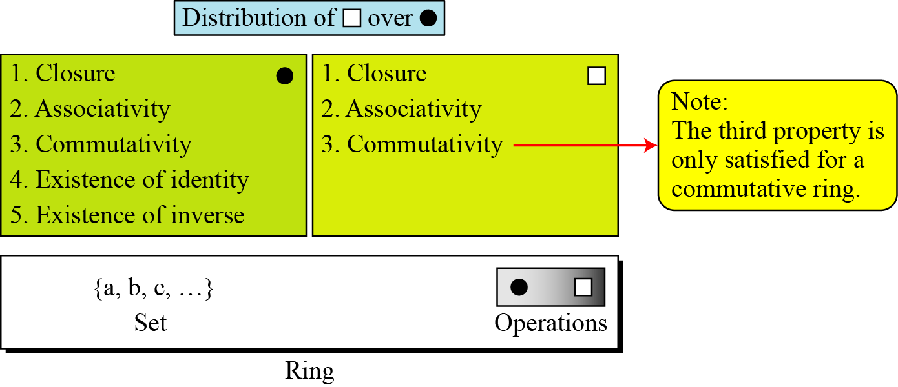
Ring
A ring, R = <{…}, +,*>, is an algebraic structure with two operations
  Respect to first operation ‘+’ (also called addition) R is an abelian group
  Respect to second operation (normally called multiplication) ‘*’, R is semi group (i.e., closure and associative rules are satisfied
  *’ is distributive over ‘+’
    a*(b+c) = a*b +a*c
The set Z with two operations, addition and multiplication, is a commutative ring. We show it by R = <Z, +, ×>. Addition satisfies all of the five properties; multiplication satisfies only three properties.
  If ‘*’ is commutative, R is commutative ring
B C Dhara, Dept. of IT, JU

Slide 20
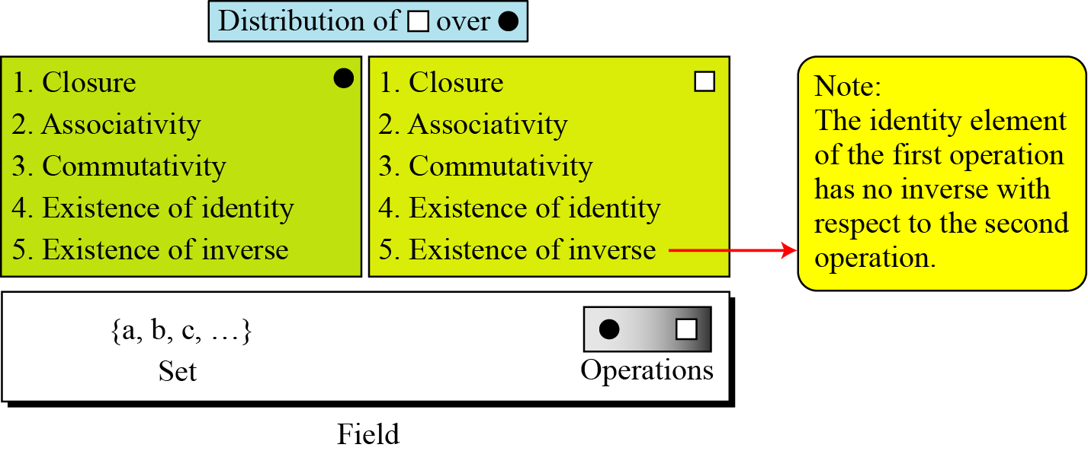
Field
A field, denoted by F = <{…}, +, *> is
{…} is a commutative group respect to the first operation ‘+’
{…}- {0} (0 is the identity of ‘+’) is a commutative group respect to ‘*’
0 has no multiplicative inverse
B C Dhara, Dept. of IT, JU

Slide 21
Finite field
Finite field is important in cryptography
A field with finite number is called finite field
Galois showed that for a field to be finite, the number of elements should be p^{n}, where p is a prime and n is a positive integer
B C Dhara, Dept. of IT, JU

Slide 22
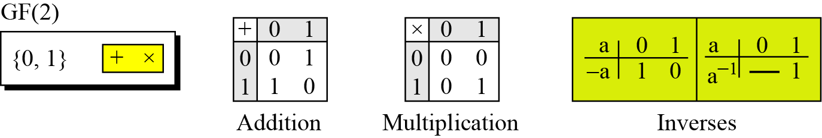
Galois field GF(p)
When n = 1, we have GF(p) field. This field can be the set Z_{p}, {0, 1, …, p − 1}, with two arithmetic operations
A very common field in this category is GF(2) with the set {0, 1} and two operations, addition and multiplication, as shown in Figure 4.6.
B C Dhara, Dept. of IT, JU

Slide 23
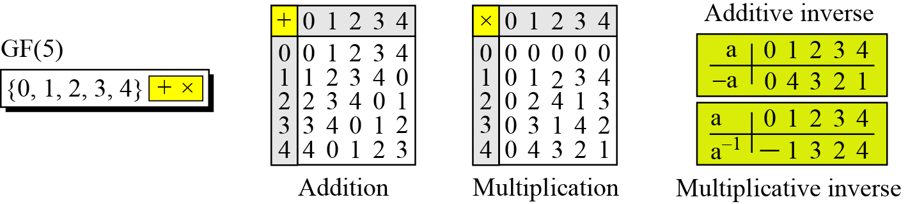
Galois field GF(p) (contd…)
We can define GF(5) on the set Z₅ (5 is a prime) with addition and multiplication operators as shown below
B C Dhara, Dept. of IT, JU

Slide 24
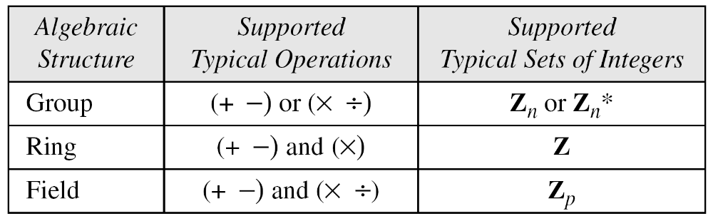
Summary
B C Dhara, Dept. of IT, JU

Slide 25
GF(2^{n})
In cryptography, we often need to use four operations (addition, subtraction, multiplication, and division)
In other words, we need to use fields
We can work in GF(p) where p is the largest number less than 2^{n}
  But, numbers between p and 2^{n} -1 cannot be handled
In GF(2^{n}), we have a set of 2^{n} elements
  The elements in this set are n-bit words
B C Dhara, Dept. of IT, JU

Slide 26
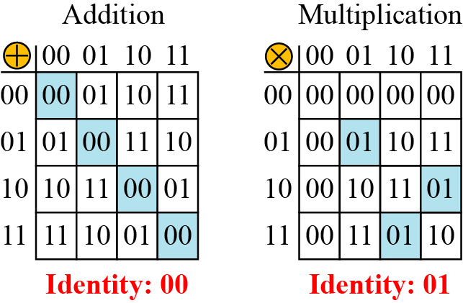
GF(2^{n}) (contd…)
Let us define a GF(2²) field in which the set has four 2-bit words: {00, 01, 10, 11}. We can redefine addition and multiplication for this field in such a way that all properties of these operations are satisfied
00, 01,…, 11 cannot be considered as integer from 0 to 3
Addition and multiplication are defined in terms of polynomial
B C Dhara, Dept. of IT, JU

Slide 27
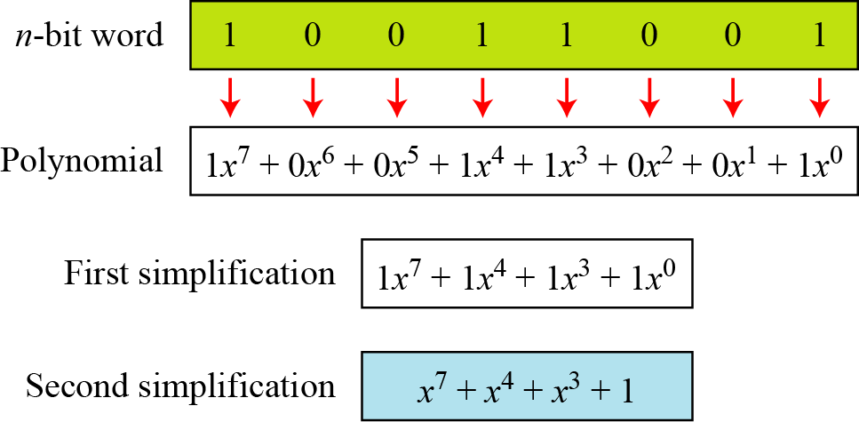
Polynomials
A polynomial of degree n − 1 is an expression like
where a_{i} is called coefficient of the i^{th} term.
8-bit word 10011001 represents as
B C Dhara, Dept. of IT, JU

Slide 28
Polynomials (contd…)
To find the 8-bit word related to the polynomial x⁵ + x² + x
  we first supply the omitted terms
  Since n = 8, it means the polynomial is of degree 7
  The expanded polynomial is
  Related 8-bit word is 00100110
B C Dhara, Dept. of IT, JU

Slide 29
Operations on polynomials
Any operation on polynomial involves two operations:
  operation on coefficients and
  operations on two polynomials
Operations on coefficients (0/1) use GF(2)
For operations on polynomials need GF(2^{n})
B C Dhara, Dept. of IT, JU

Slide 30
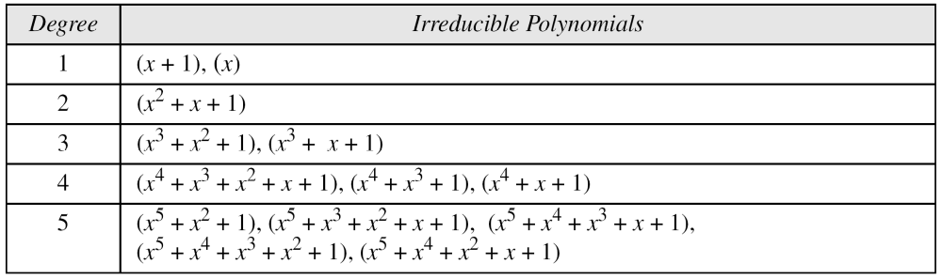
Modulus respect to polynomial
Addition of two polynomials never create a polynomial out side the set
Multiplication of two polynomials may generates a polynomial whose degree > n-1
  We need a polynomial of degree n, respect to which we have to take remainder
  The modulus polynomial takes as prime polynomial
  Prime polynomial is irreducible, i.e., no polynomial can divides it
B C Dhara, Dept. of IT, JU

Slide 31
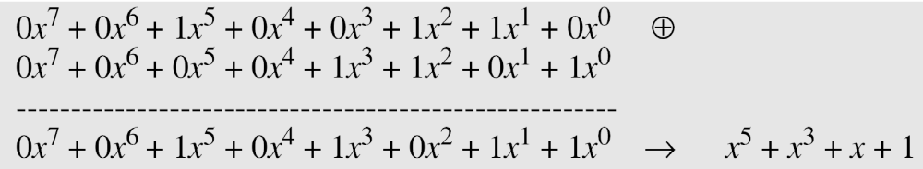
Addition operation
Addition (or subtraction) over GF(2)
(x⁵ + x² + x) ⊕ (x³ + x² + 1) in GF(2⁸), the symbol ⊕ to show that we mean polynomial addition
Additive identity: zero polynomial
Additive inverse: polynomial itself
B C Dhara, Dept. of IT, JU

Slide 32
Multiplication
1. The coefficient multiplication is done in GF(2).
2. The multiplying x^{i} by x^{j} results in x^{i+j}.
3. The multiplication may create terms with degree more than n − 1, which means the result needs to be reduced using a modulus polynomial.
B C Dhara, Dept. of IT, JU

Slide 33
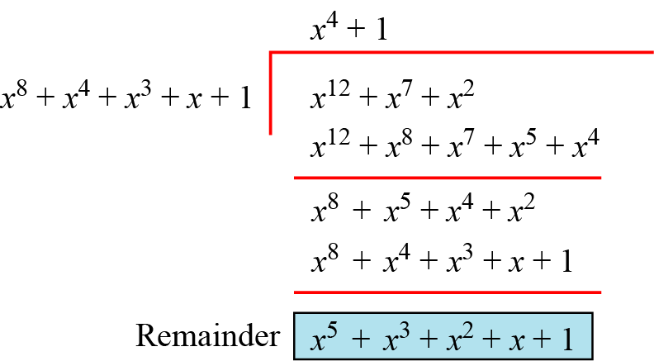
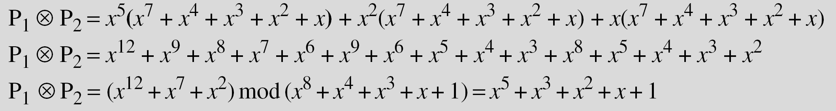
Multiplication: example
Find the result of (x⁵ + x² + x) ⊗ (x⁷ + x⁴ + x³ + x² + x) in GF(2⁸) with irreducible polynomial (x⁸ + x⁴ + x³ + x + 1), the symbol ⊗ to represent multiplication of two polynomials
Solution
To find the final result, divide the polynomial of degree 12 by the polynomial of degree 8 (the modulus) and keep only the remainder
B C Dhara, Dept. of IT, JU

Slide 34
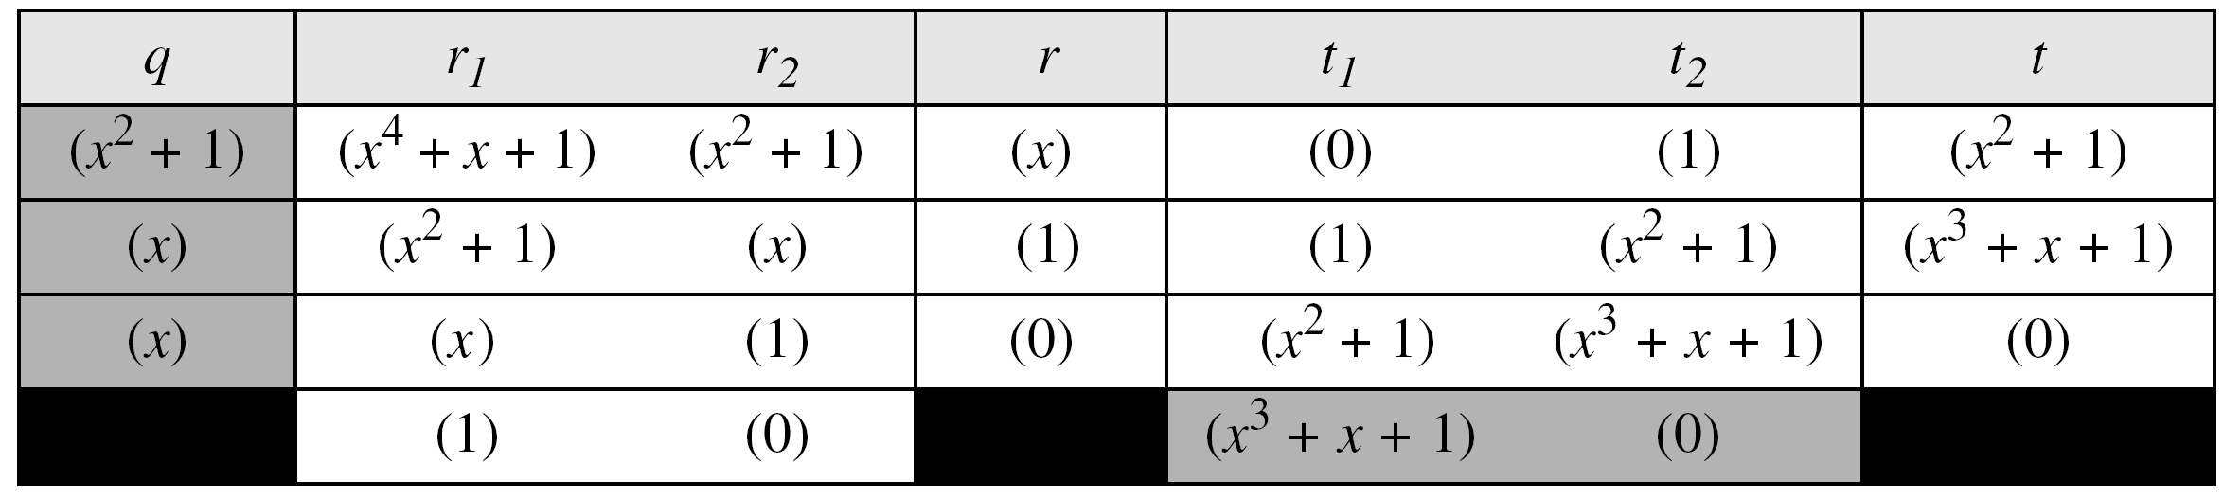
Multiplication
Multiplicative identity: 1 i.e., 00000…0001
Multiplicative inverse: extended Euclidean algorithm on the given polynomial and modulus polynomial
In GF (2⁴), find the inverse of (x² + 1) modulo (x⁴ + x + 1).
B C Dhara, Dept. of IT, JU

Slide 35
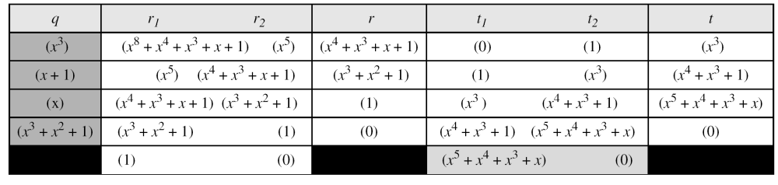
Multiplicative inverse
In GF(2⁸), find the inverse of (x⁵) modulo (x⁸ + x⁴ + x³ + x + 1).
B C Dhara, Dept. of IT, JU

Slide 36
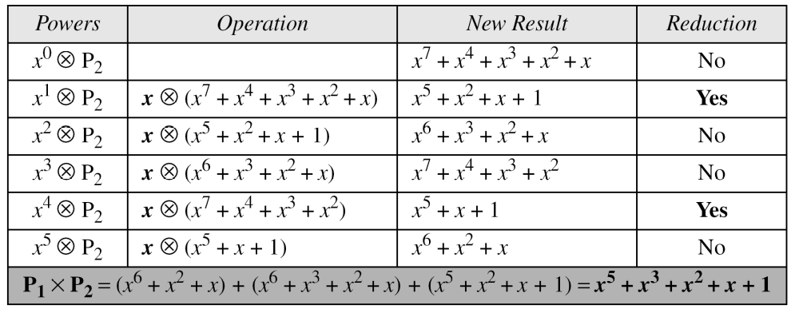
Algorithm for multiplication
Find the result of multiplying P₁ = (x⁵ + x² + x) by P₂ = (x⁷ + x⁴ + x³ + x² + x) in GF(2⁸) with irreducible polynomial (x⁸ + x⁴ + x³ + x + 1)
x⁵P₂ + x²P₂ + xP₂ mod IRP
Multiply P₂ by x, x², x³,…
B C Dhara, Dept. of IT, JU

Slide 37
Multiplication by x can be achieved by one bit left shift of P₂
Need to be reduced after multiplication if degree greater than n-1
  i.e., previously degree was n-1 (leading bit was 1)
  Reduction, after multiplication result is XOR-ed with IRP
B C Dhara, Dept. of IT, JU

Slide 38
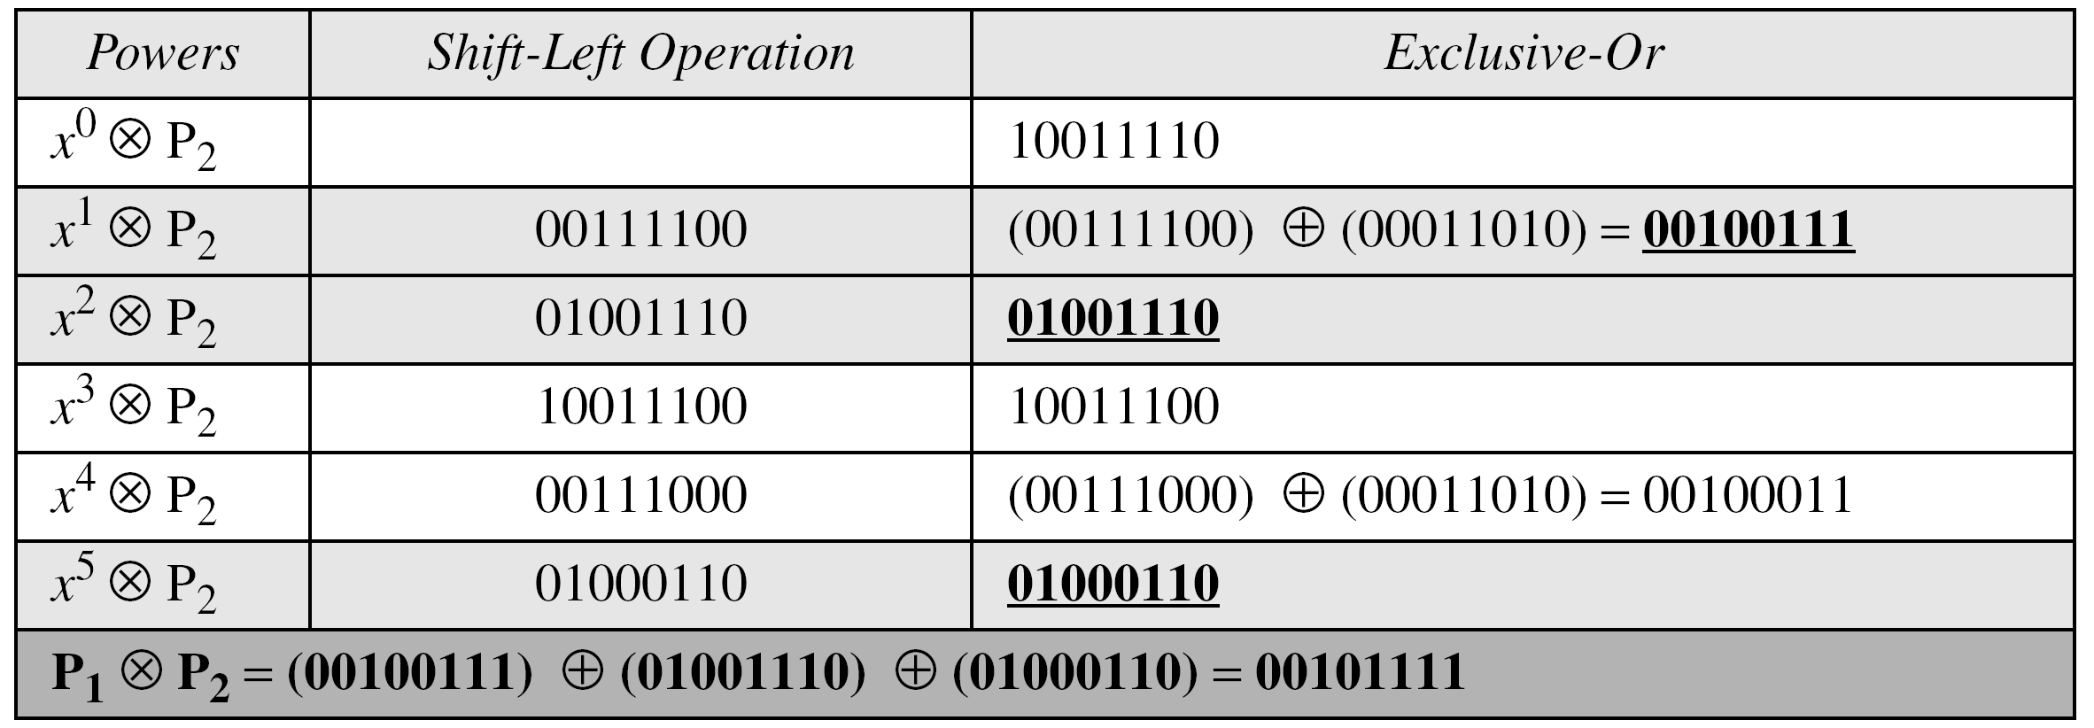
Algorithm
if leading bit of previous result ‘0’
  One left shift
if leading bit of previous result ‘1’
  One left shift
  XOR the result with least n-1 bits of IRP
    (note: IRP is with degree n
P1 = 00100110,
P2 = 10011110,
modulus = 100011011
00011011
00011011
B C Dhara, Dept. of IT, JU

Slide 39
Note
A filed GF(2^{n}) may have more than one irreducible polynomials
In addition no role of irreducible polynomial where as the result of multiplication highly depends on irreducible polynomial (like mod p)
B C Dhara, Dept. of IT, JU

Slide 40
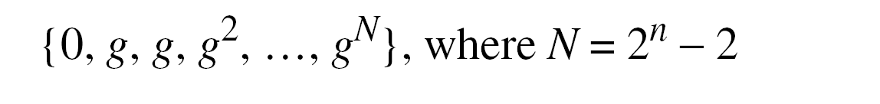
Using generator
It is easier to define the elements of GF(2^{n}) using a generator
Generator is ‘g’ where f(g)=0 for an irreducible polynomial of GF(2^{n})
Using the generator, the elements of GF(2^{n}) are
B C Dhara, Dept. of IT, JU

Slide 41
Elements of GF(2⁴): x⁴ + x + 1
g⁴ + g + 1 =0 ➔ g⁴ = g + 1
The elements 0, g⁰, g¹, g2, and g³ can be easily generated, because they are the 4-bit representations of 0, 1, x², and x³
Elements g⁴ through g¹⁴, which represent x⁴ though x¹⁴ need to be divided by the irreducible polynomial
B C Dhara, Dept. of IT, JU

Slide 42
Inverse
Additive inverse: the element itself
Multiplicative inverse: for g^{i}, it is g^{-i} where –i ≡ k mod 2^{n} -1
B C Dhara, Dept. of IT, JU

Slide 43
Operations
B C Dhara, Dept. of IT, JU

Slide 44
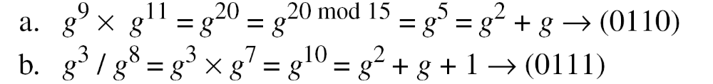
Operations (contd…)
B C Dhara, Dept. of IT, JU

